Slide 1


Monte-carlo Classic
Team 4

Slide 2
Team Members
Suhas Kabinna
Edima Udo
Hao Wu
Kamran Tayyab

Slide 3
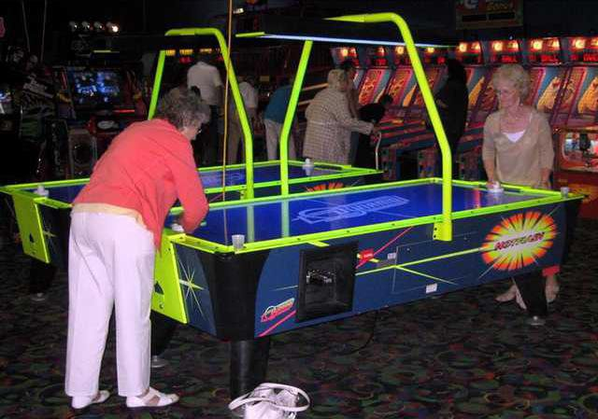
Allows seniors to get up and moving
Helps with social interactions
Feeling of accomplishment/ purpose
Nostalgia

Slide 4
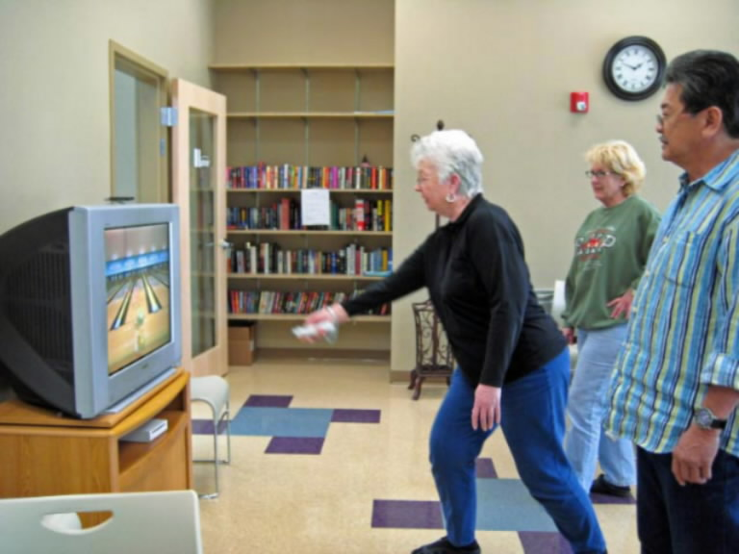

Future Possibilities
Use current platform to implement more interact games
Add more cooperative games for seniors to play
Add games such as ‘Cancel’ to help improve memory/hand coordination

